Slide 1

Process Management

Slide 2
Process Management
process can be thought of as a program in execution.
A process will need certain resources-such as CPU time, memory, files, and I/O devices-to accomplish its task.
These resources are allocated to the process either when it is created or while it is executing.
A process is the unit of work in most systems. Such a system consists of a collection of processes.

Slide 3
A process is a program in execution.
It includes:
The code being executed
The data and variables it uses
The resources it has (CPU, memory, files)
The state it's in (running, waiting, etc.)

Slide 4
Process state
State of a process is defined in part by the current activity of that process. Each process may be in one of following states
New: The process is being created.
Ready: The process is waiting to be assigned to a processor.
Running: Instructions are being executed.
Waiting: The process is waiting for some event to occur (such as an I/O completion or reception of a signal).
Terminated: The process has finished execution.

Slide 5
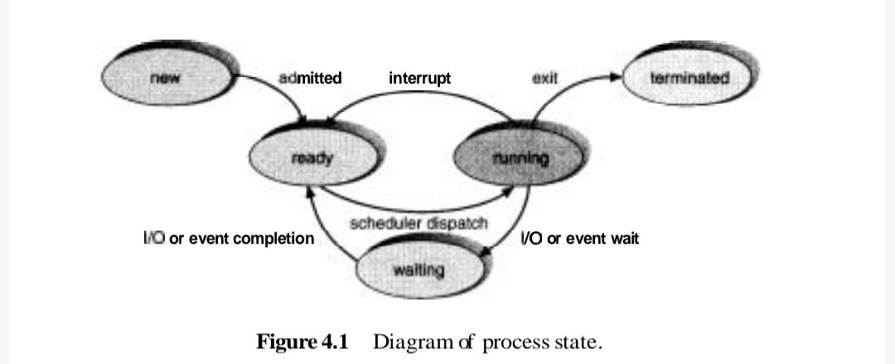
Process state transition diagram

Slide 6
New State
The new state is the initial state of a process.
When a program in secondary memory is initiated for execution, the process is said to be in a new state.
Ready State
Once the process is loaded into the main memory and is prepared for execution, it transitions from the new state to the ready state.
At this point, the process is waiting for the processor to execute it.
In a multiprogramming environment, several processes may be in the ready state simultaneously.

Slide 7
Run State
Once the CPU is allocated for execution, the process transitions from the ready state to the run state.
Terminate State
Upon completion of a process's execution, it transitions from the run state to the terminate state.
Process is killed as well as PCB(process control block) is deleted.
The resources allocated to the process will be released or deallocated.

Slide 8
Block or Wait State
If a process requires an Input/Output operation or a blocked resource during execution, it transitions from the run state to the block or wait state.
The process continues to wait in the main memory and does not require CPU.
Once the I/O operation is completed or the resource becomes available, the process transitions to the ready state.

Slide 9
Process state transition diagram
Only one process can be running on any processor at any instant, although many processes may be ready and waiting.

Slide 10
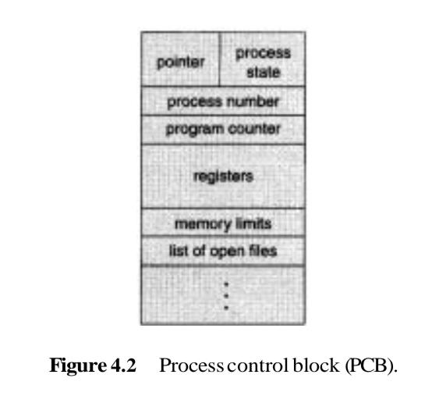
Process Control Block

Slide 11
Process ID (PID): A unique identifier for the process.
Process State: Indicates the current status of the process (e.g., running, ready, waiting).
Program Counter: Points to the next instruction to be executed in the process.
CPU Registers: Stores the values of CPU registers used by the process during execution.
CPU Scheduling Information: Includes priority, scheduling parameters, and other data needed for scheduling decisions.
Memory Management Information: Contains details about the memory allocated to the process.
Accounting Information: Tracks resource usage like CPU time, memory usage, and I/O operations.
I/O Status Information: Keeps track of the I/O devices allocated to the process.
Open Files: A list of files currently opened by the process.
Pointers: Links to other PCBs, especially in the context of parent-child relationships or scheduling queues.

Slide 12
CPU registers
Registers are the fastest memory in a computer system.They allow the CPU to access data quickly without needing to fetch it from slower memory like RAM.
Register Type | Function
Accumulator (ACC) | Stores results of arithmetic and logic operations.
Program Counter (PC) | Holds the address of the next instruction.
Instruction Register (IR) | Holds the current instruction being executed.
Memory Address Register (MAR) | Holds the address in memory to read/write data.
Memory Data Register (MDR) | Holds data being transferred to/from memory.
General Purpose Registers (e.g., AX, BX, R1, R2) | Temporarily store data, variables, or results.
Stack Pointer (SP) | Points to the top of the stack in memory.

Slide 13
Process Control Block
Process state: The state may be new, ready, running, waiting, halted, and so on.
Program counter: The counter indicates the address of the next instruction to be executed for this process.
CPU registers: The registers vary in number and type, depending on the computer architecture. They include accumulators, index registers, stack pointers, and general-purpose registers, plus any condition-code information.

Slide 14
Process Control Block
CPU-scheduling information: This information includes a process priority, pointers to scheduling queues, and any other scheduling parameters.
Memory-management information: This information may include such information as the value of the base and limit registers, the page tables, or the segment tables, depending on the memory system used by the operating system

Slide 15
Process Control Block
Accounting information: This information includes the amount of CPU and real time used, time limits, account numbers, job or process numbers, and so on. I /O status information: The information includes the list of I/O devices allocated to this process, a list of open files, and so on.

Slide 16
Context Switching
When CPU switches to another process, the system must save the state of the old process and load the saved state for the new process via a context switch
Context of a process represented in the PCB
Context-switch time is overhead; the system does no useful work while switching
The more complex the OS and the PCB, the longer the context switch time dependent on hardware support
Some hardware provides multiple sets of registers per CPU ie; multiple contexts loaded at once (no. of registers)

Slide 17
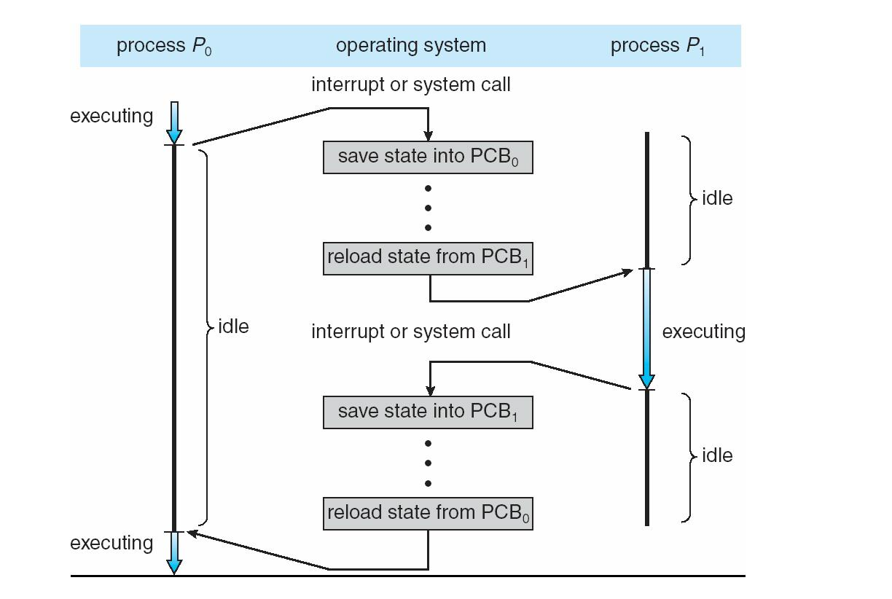
Context Switching

Slide 18
Process Scheduling
Maximize CPU use, quickly switch processes onto CPU for time sharing
Process scheduler selects among available processes for next execution on CPU
Maintains scheduling queues of processes
Job queue – set of all processes in the system
Ready queue – set of all processes residing in main memory, ready and waiting to execute
Device queues – set of processes waiting for an I/O device processes migrate among the various queues

Slide 19
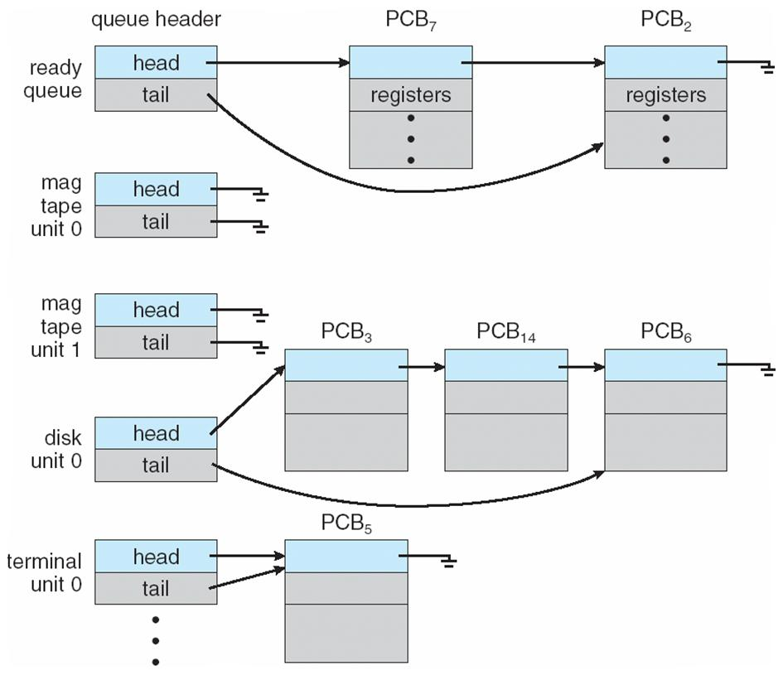
Process Scheduling

Slide 20
Process Scheduling
A new process is initially put in the ready queue. It waits in the ready queue until it is selected for execution (or dispatched).
Once the process is assigned to the CPU and is executing, one of several events could occur: The process could issue an I/O request, and then be placed in an I/O queue. The process could create a new subprocess and wait for its termination. The process could be removed forcibly from the CPU, as a result of an interrupt, and be put back in the ready queue.

Slide 21
Process Scheduling
In first two cases, the process eventually switches from the waiting state to the ready state, and is then put back in the ready queue.
A process continues this cycle until it terminates, at which time it is removed from all queues and has its PCB and resources deallocated

Slide 22
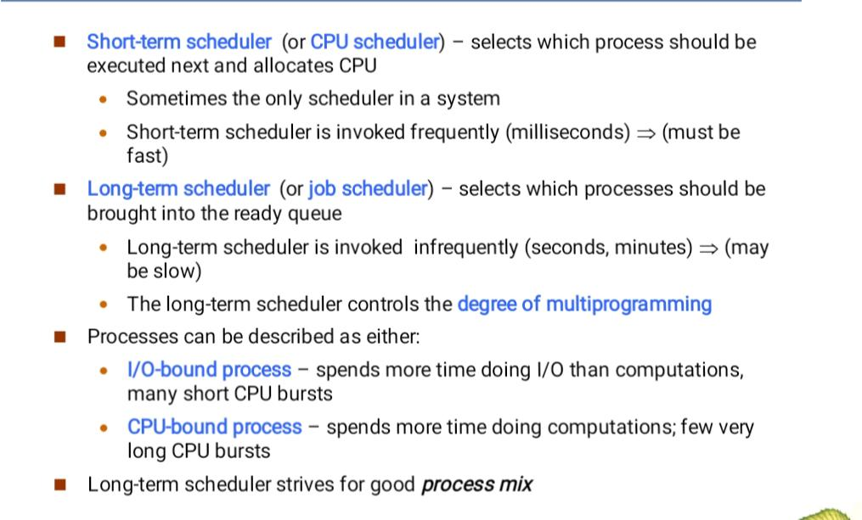
Schedulers

Slide 23
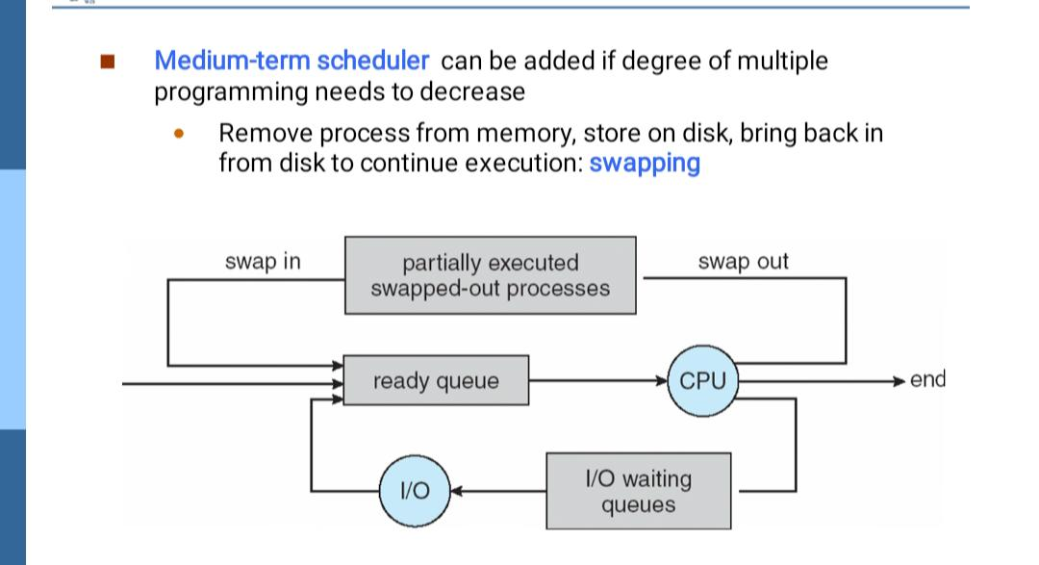
Schedulers

Slide 24
CPU Scheduling
CPU scheduling is the basis of multiprogramming operating systems.
By switching the CPU among processes, the operating system can make the computer more productive.

Slide 25
CPU Scheduler
Whenever the CPU becomes idle, the operating system must select one of the processes in the ready queue to be executed.
The selection process is carried out by the short-term scheduler (or CPU scheduler).
The scheduler selects from among the processes in memory that are ready to execute, and allocates the CPU to one of them

Slide 26
Dispatcher
Dispatcher is a special program which comes into play after the scheduler.
When the scheduler completes its job of selecting a process, it is the dispatcher which takes that process to the desired state/queue.

Slide 27
Functions of Dispatcher
Function involves:
Switching context
Switching to user mode
Jumping to the proper location in the user program to restart that program

Slide 28
Imagine you're using your phone and open Spotify. You select a song, adjust volume, scroll playlists — all of this is done in user mode.
You’re using the Spotify app, and you request to play a song. The kernel handles reading the song file from disk and sending audio to your speakers. You (user mode) can request, but only the kernel mode can execute that hardware-level task.

Slide 29
Scheduling Criteria
Many criteria have been suggested for comparing CPU-scheduling algorithms. Mainly used for determining the best algorithm.
1) CPU utilization: We want to keep the CPU as busy as possible. CPU utilization may range from 0 to 100 percent. In a real system, it should range from 40 percent (for a lightly loaded system) to 90 percent (for a heavily used system).

Slide 30
Scheduling Criteria
Throughput: One measure of work is the number of processes completed per time unit, called throughput. For long processes, this rate may be 1 process per hour; for short transactions, throughput might be 10 processes per second.

Slide 31
Scheduling Criteria
Turnaround time: The interval from the time of submission of a process to the time of completion is the turnaround time. Turnaround time is the sum of the periods spent waiting to get into memory, waiting in the ready queue, executing on the CPU, and doing I/O.

Slide 32
Scheduling Criteria
Waiting time: Waiting time is the sum of the periods spent waiting in the ready queue.
Response time: Time from the submission of a request until the first response is produced. This measure, called response time, is the amount of time it takes to start responding, but not the time that it takes to output that response.
maximize CPU utilization and throughput, and to minimize
turnaround time, waiting time, and response time

Slide 33
Metric | Definition | Formula
Waiting Time (WT) | Total time a process spends in the ready queue (not executing, just waiting). | WT = Turnaround Time - Burst Time
Turnaround Time (TAT) | Total time from submission of a process to its completion. | TAT = Completion Time - Arrival Time

Slide 34
Scheduling Algorithms
CPU scheduling deals with the problem of deciding which of the processes in the ready queue is to be allocated the CPU.

Slide 35
First-Come, First-Served Scheduling
With this scheme, the process that requests the CPU first is allocated the CPU first. The implementation of the FCFS policy is easily managed with a FIFO queue.

Slide 36
To understand the First Come, First Served (FCFS) scheduling algorithm effectively, we'll use two examples -
One where all processes arrive at the same time,
Another where processes arrive at different times.
We'll create Gantt charts for both scenarios and calculate the turnaround time and waiting time for each process.

Slide 37
Scenario 1: Processes with Same Arrival Time
Consider the following table of arrival time and burst time for three processes p1, p2 and p3
Process | Arrival Time | Burst Time
p1 | 0 | 5
p2 | 0 | 3
p3 | 0 | 8

Slide 38
Step-by-Step Execution:
P1 will start first and run for 5 units of time (from 0 to 5).
P2 will start next and run for 3 units of time (from 5 to 8).
P3 will run last, executing for 8 units (from 8 to 16).

Slide 39
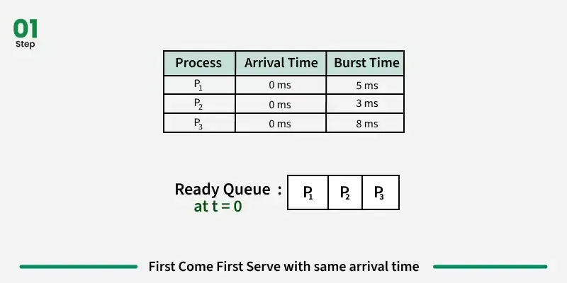

Slide 40
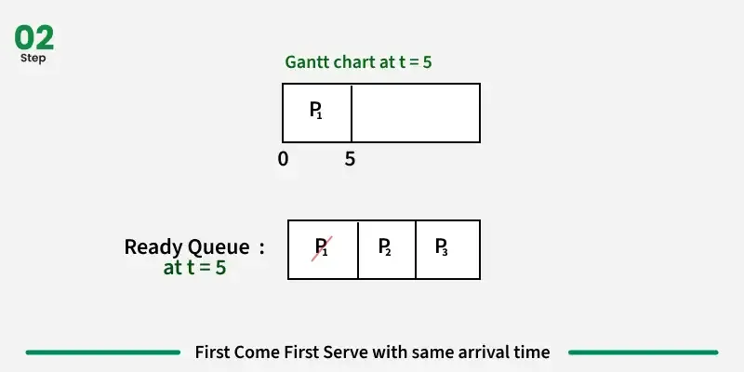

Slide 41
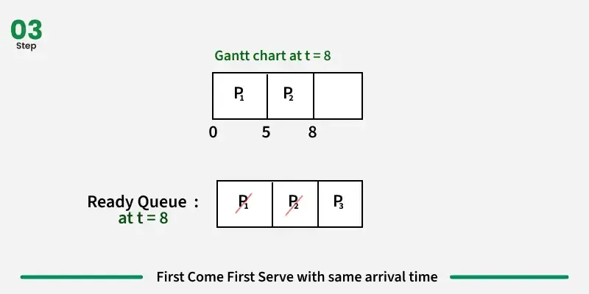

Slide 42
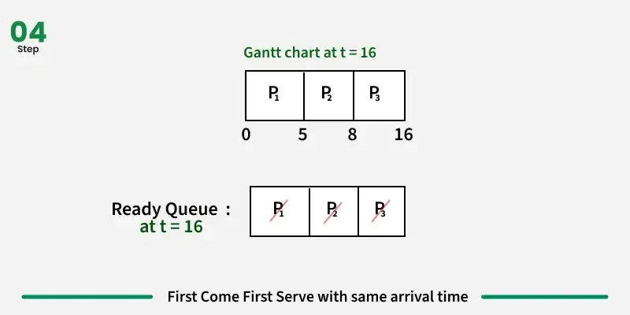

Slide 43
Scenario 2: Processes with Different Arrival Times
Consider the following table of arrival time and burst time for three processes P1, P2 and P3
Process | Arrival Time (AT) | Burst Time (BT)
P1 | 2 ms | 5 ms
P2 | 0 ms | 3 ms
P3 | 4 ms | 4 ms

Slide 44
Step-by-Step Execution:
P2 arrives at time 0 and runs for 3 units, so its completion time is:
Completion Time of P2=0+3=3
P1 arrives at time 2 but has to wait for P2 to finish. P1 starts at time 3 and runs for 5 units. Its completion time is:
Completion Time of P1=3+5=8
P3 arrives at time 4 but has to wait for P1 to finish. P3 starts at time 8 and runs for 4 units. Its completion time is:
Completion Time of P3=8+4=12

Slide 45
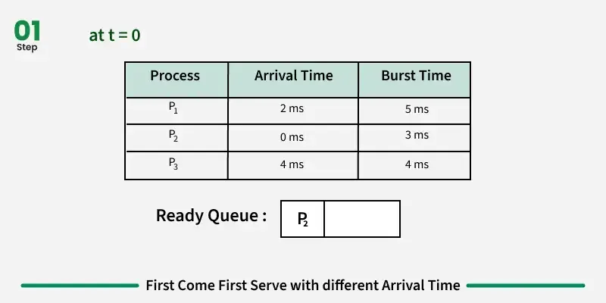

Slide 46
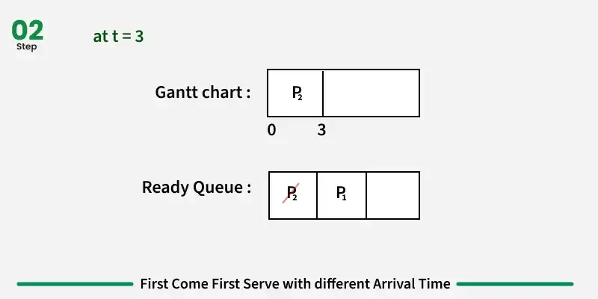

Slide 47
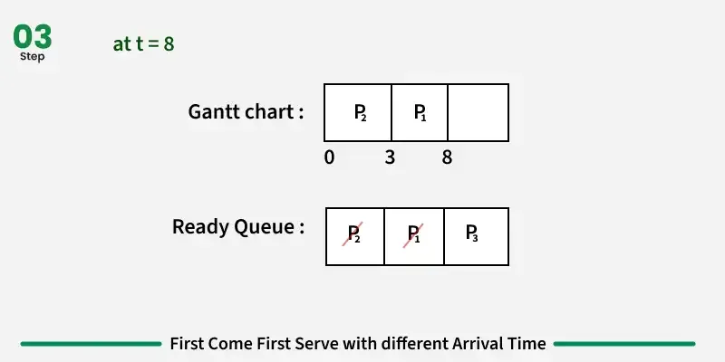

Slide 48
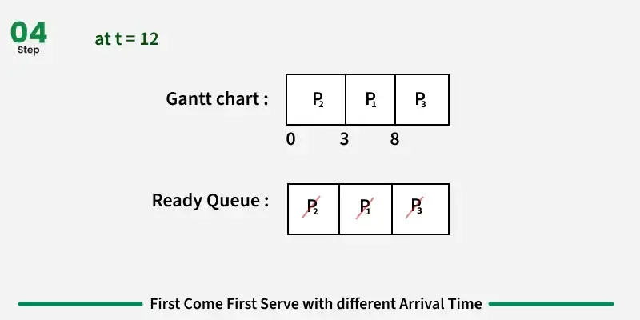
12

Slide 49
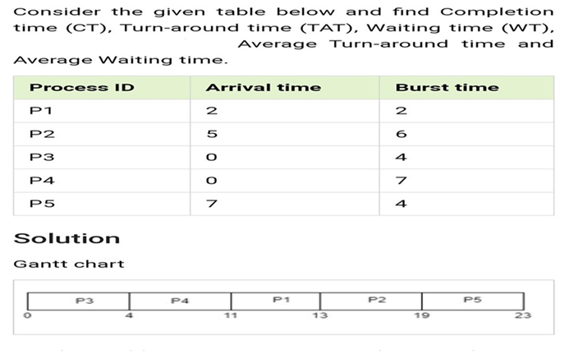

Slide 50
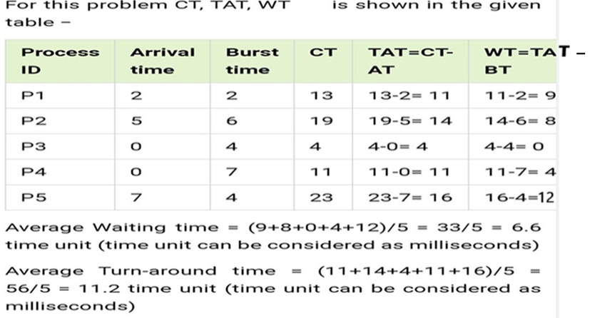

Slide 51
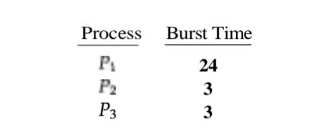
Consider the following set of processes that arrive at time 0, with the length of the CPU-burst time given in milliseconds:

Slide 52

First-Come, First-Served Scheduling

Slide 53
Pre-emptive and Non pre-emptive scheduling
CPU scheduling decisions may take place under the following four circumstances:
1.When a process switches from the running state to the waiting state (for example, I/O request)
2.When a process switches from the running state to the ready state (for
example, when an interrupt occurs)
3. When a process switches from the waiting state to the ready state (for
example, completion of I/O)
4. When a process terminates

Slide 54
Preemptive and Non preemptive scheduling
When scheduling takes place only under circumstances 1 and 4, we say the scheduling scheme is non pre-emptive; otherwise, the scheduling scheme is pre-emptive.
Under non pre-emptive scheduling, once the CPU has been allocated to a process, the process keeps the CPU until it releases the CPU either by terminating or by switching to the waiting state.

Slide 55
Shortest job first scheduling- Non pre-emptive
When the CPU is available, it is assigned to the process that has the smallest next CPU burst.
If two processes have the same length next CPU burst, FCFS scheduling is used to break the tie. Note that a more appropriate term would be the shortest next CPU burst, because the scheduling is done by examining the length of the next CPU burst of a process, rather than its total length

Slide 56
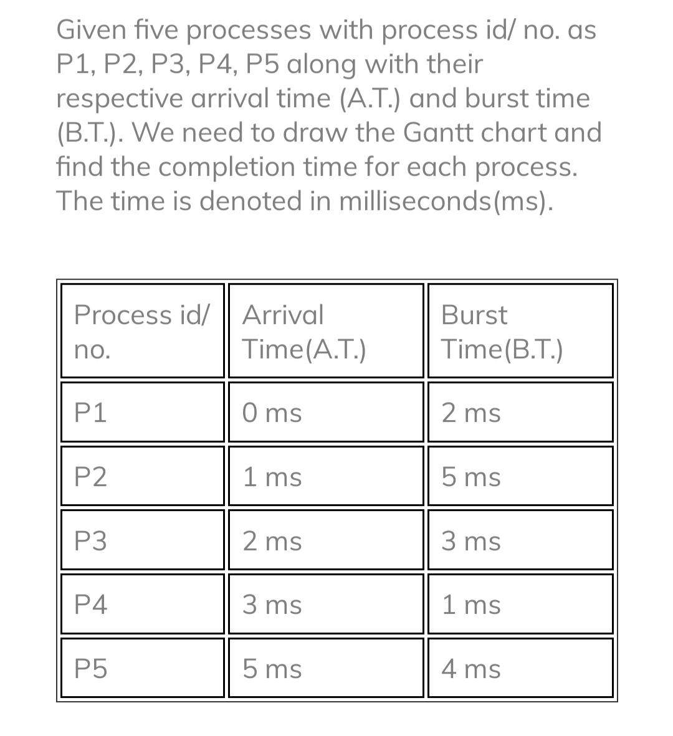
Shortest job first scheduling- Non preemptive

Slide 57

Shortest job first scheduling- Non premptive

Slide 58
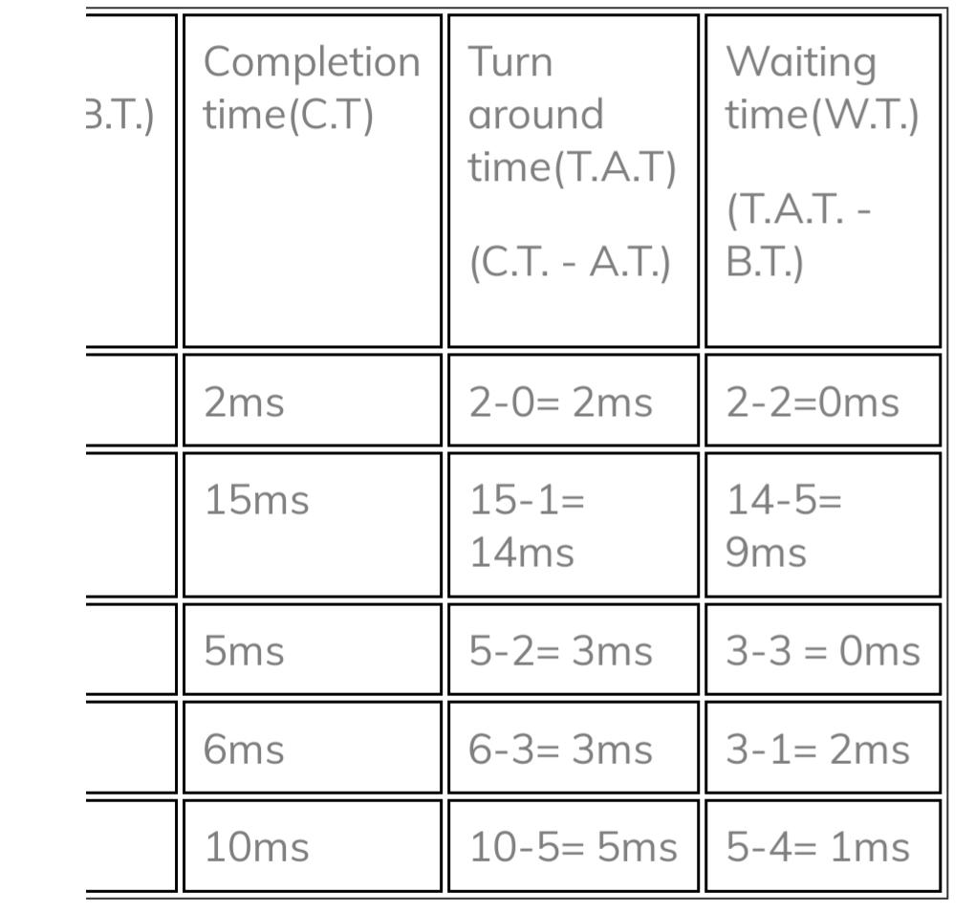
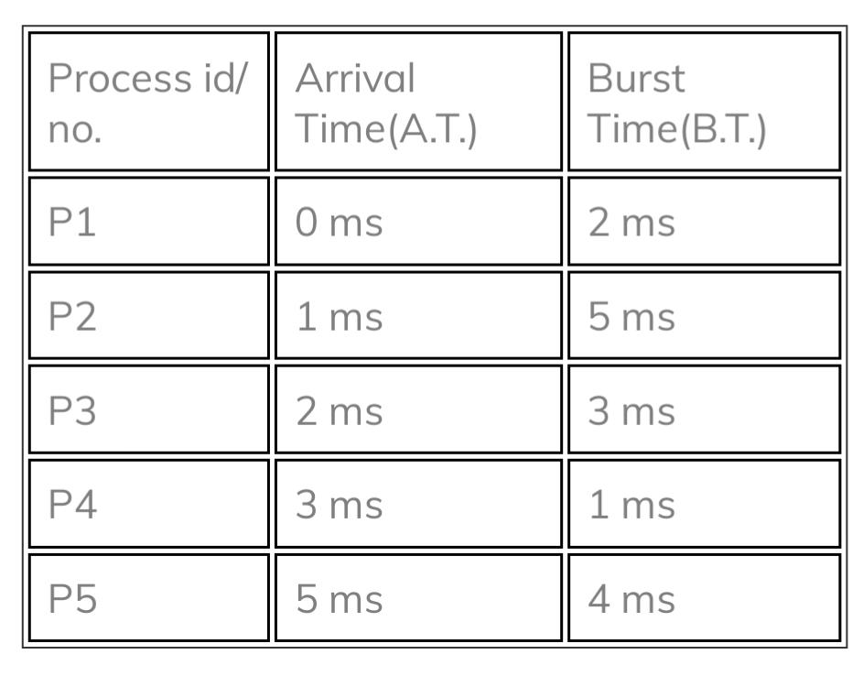

Slide 59
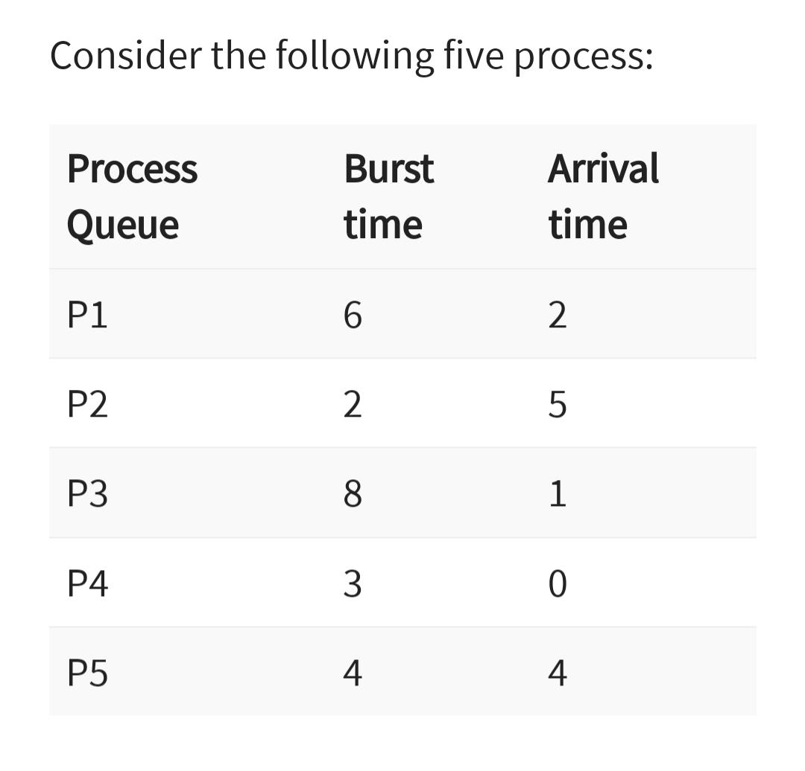
Shortest job first scheduling- preemptive
Process id | Arrival Time | Burst Time | CT | TAT | WT
P1 | 1 | 7 | 8 | 7 | 0
P2 | 2 | 5 | 16 | 14 | 9
P3 | 3 | 1 | 9 | 6 | 5
P4 | 4 | 2 | 11 | 7 | 5
P5 | 5 | 8 | 24 | 19 | 11

Slide 60
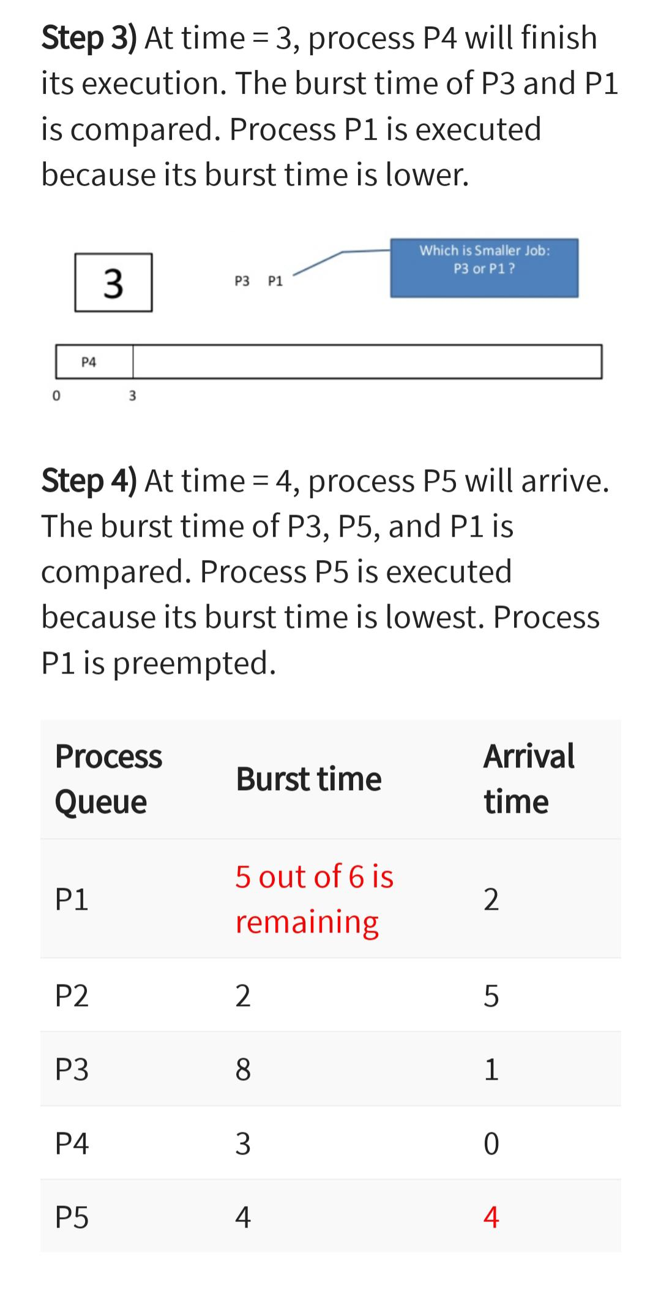
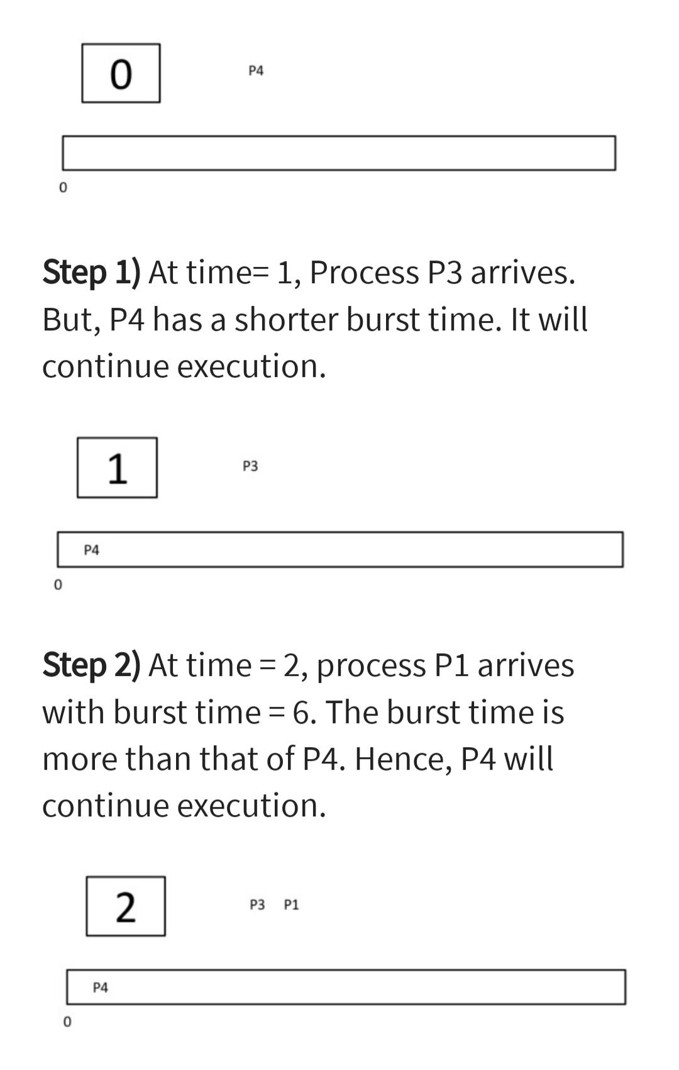
Shortest job first scheduling- preemptive

Slide 61
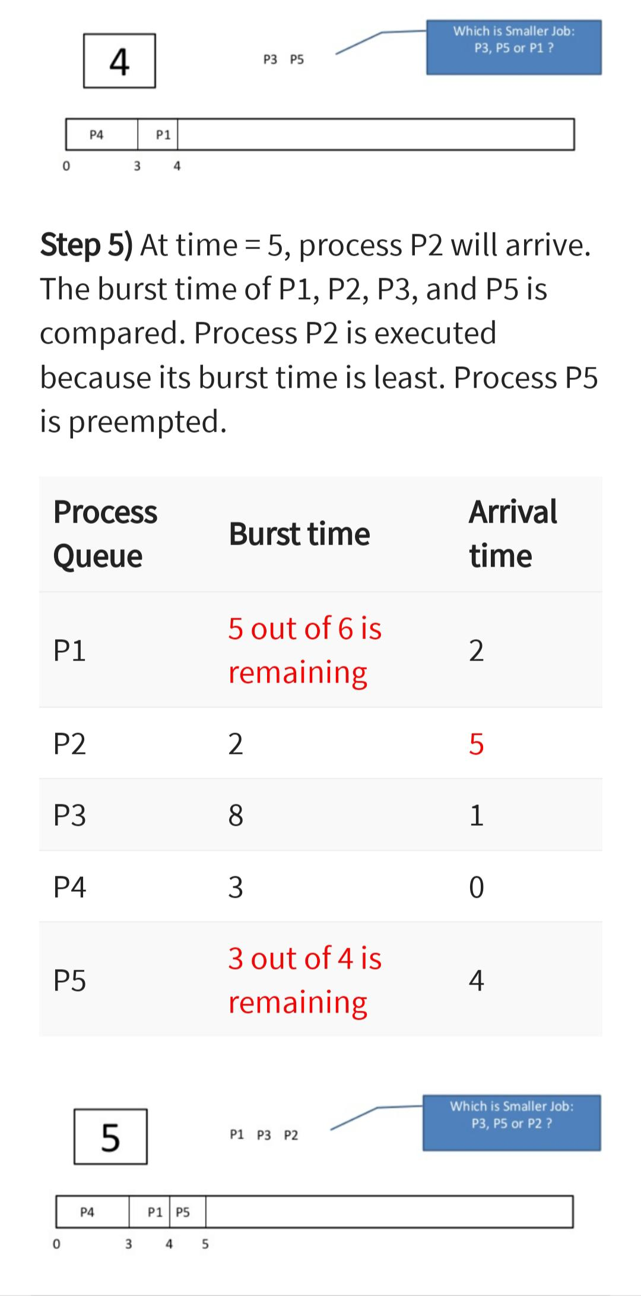
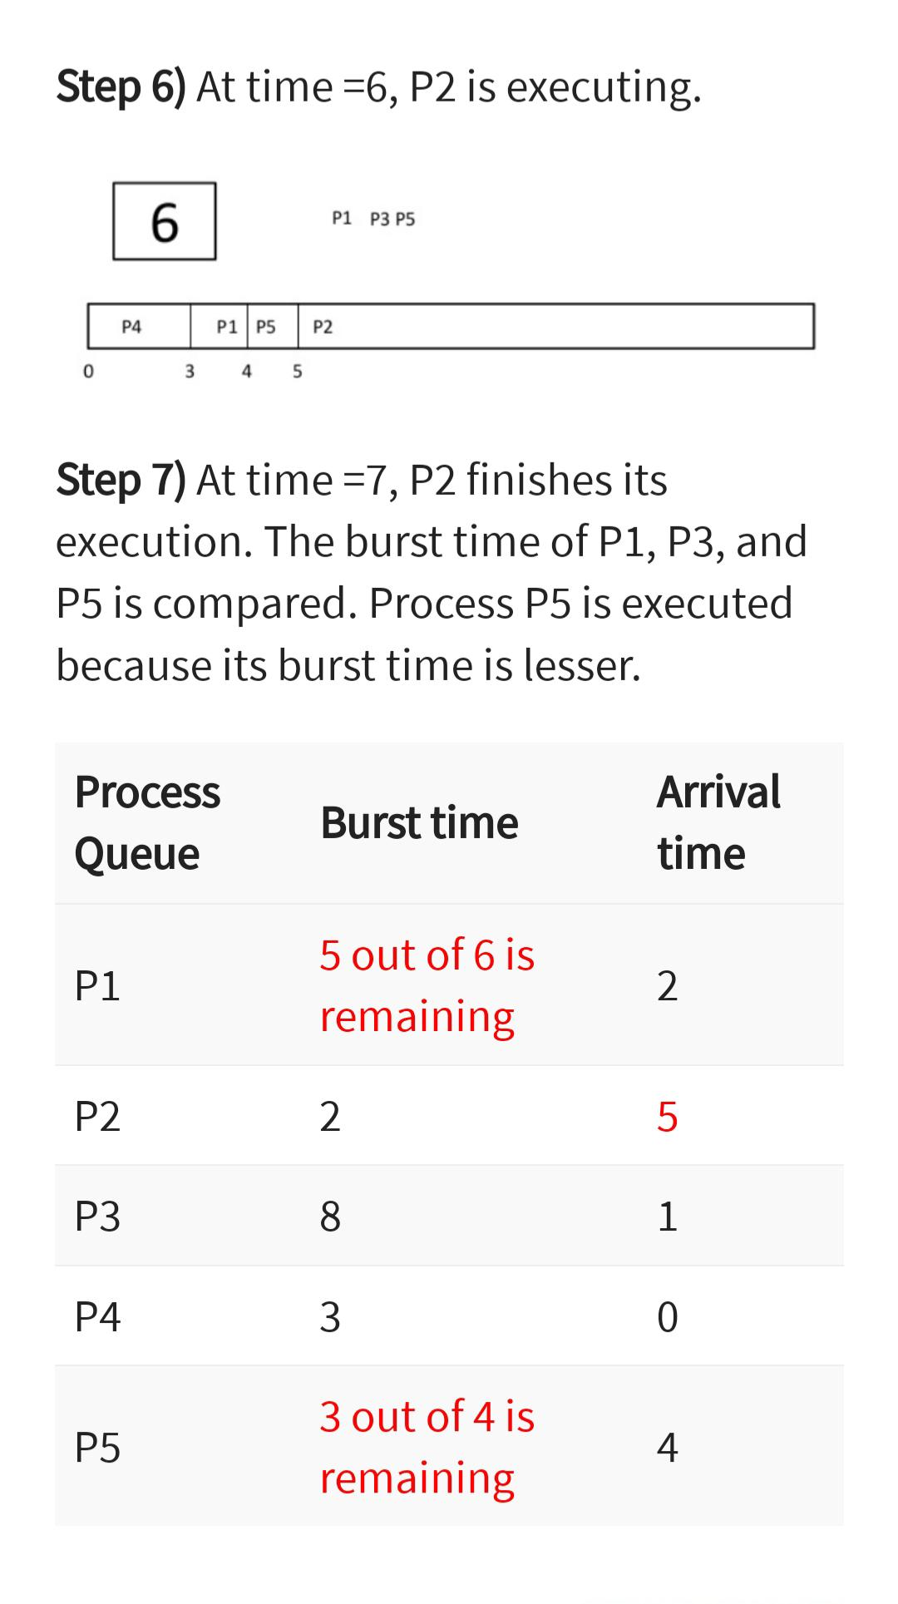
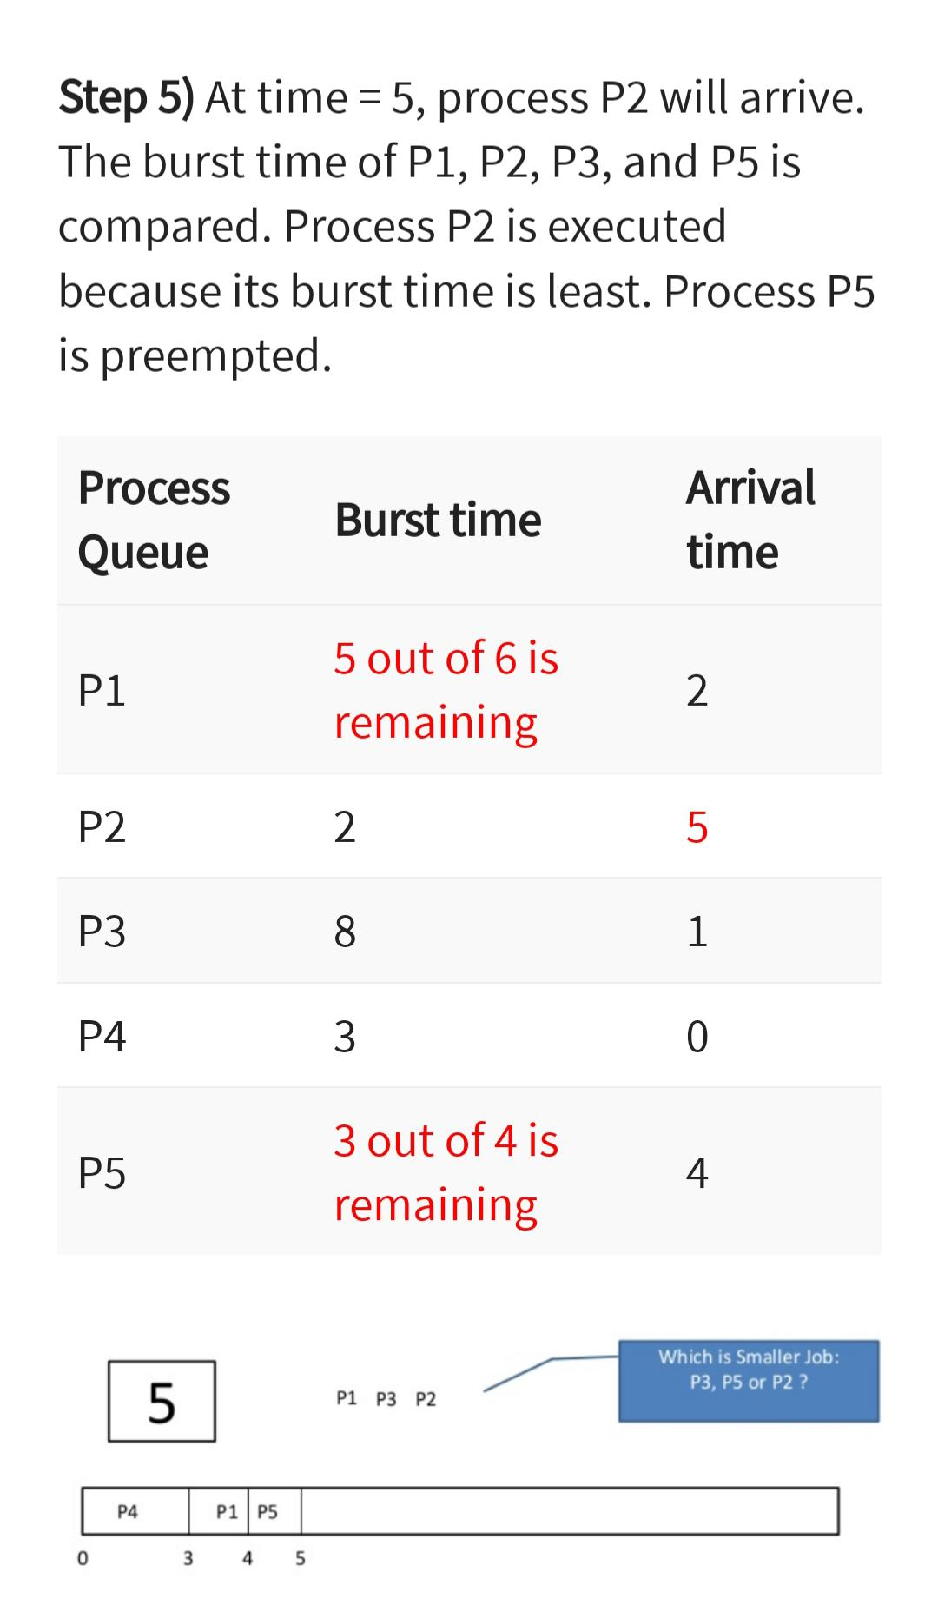
Shortest job first scheduling- premptive

Slide 62
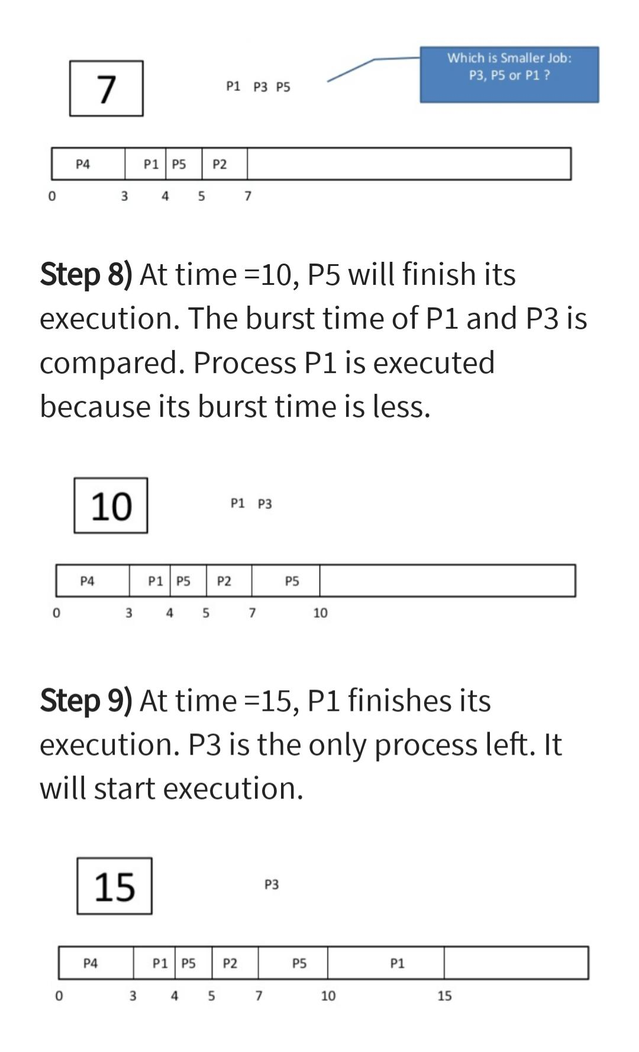
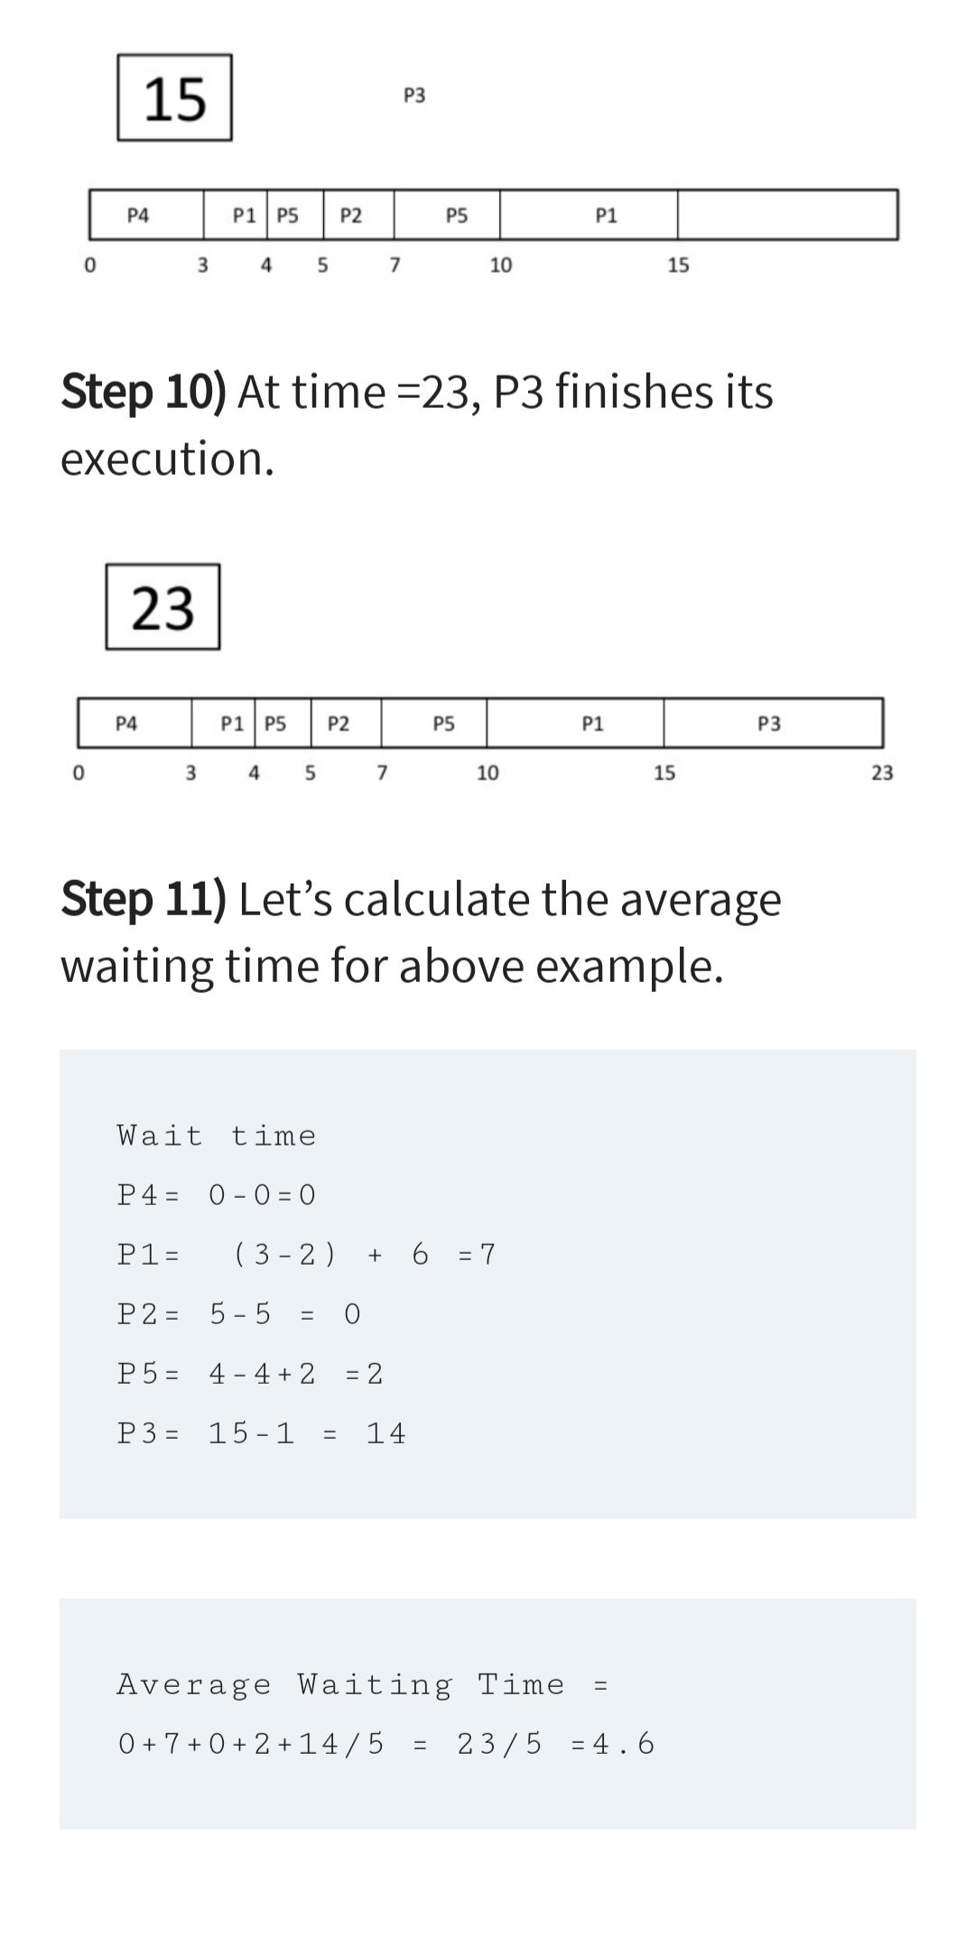
Shortest job first scheduling- pre-emptive

Slide 63
Priority scheduling
In Priority scheduling, there is a priority number assigned to each process.
In some systems, the lower the number, the higher the priority. While, in the others, the higher the number, the higher will be the priority.
The Process with the higher priority among the available processes is given the CPU

Slide 64
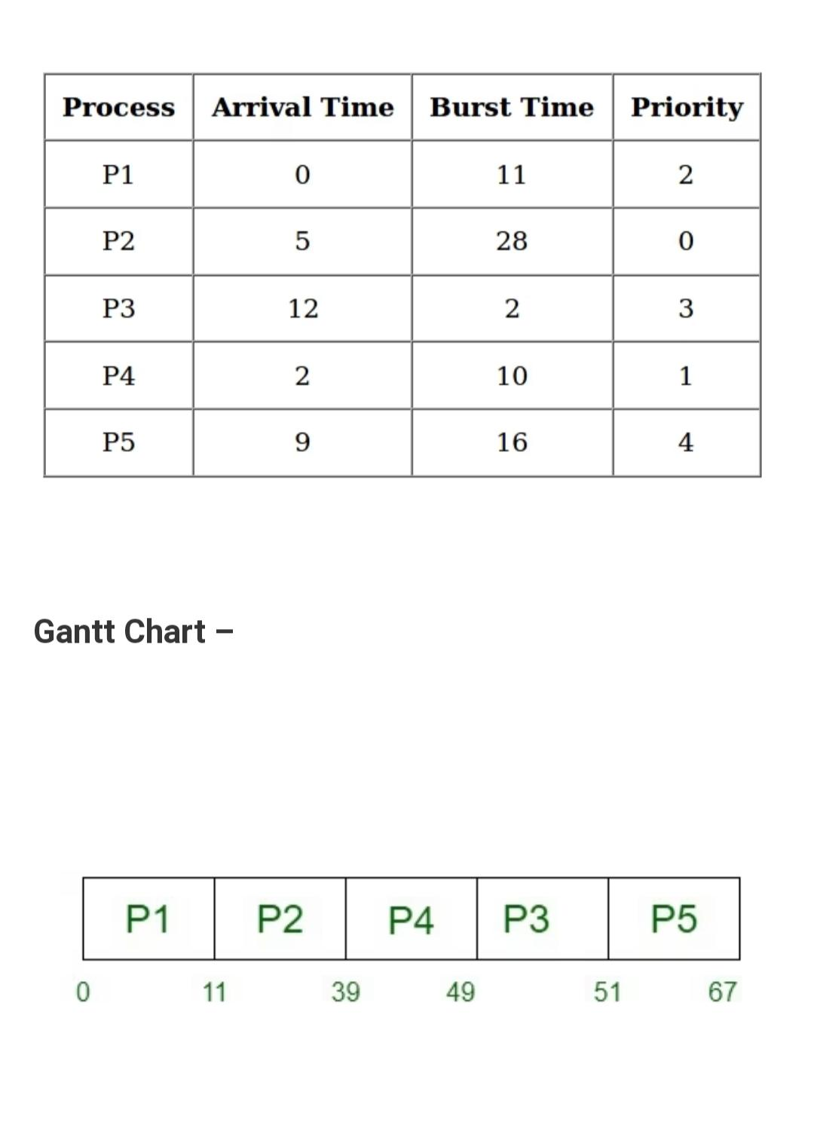
Priority scheduling-Nonpreemptive

Slide 65
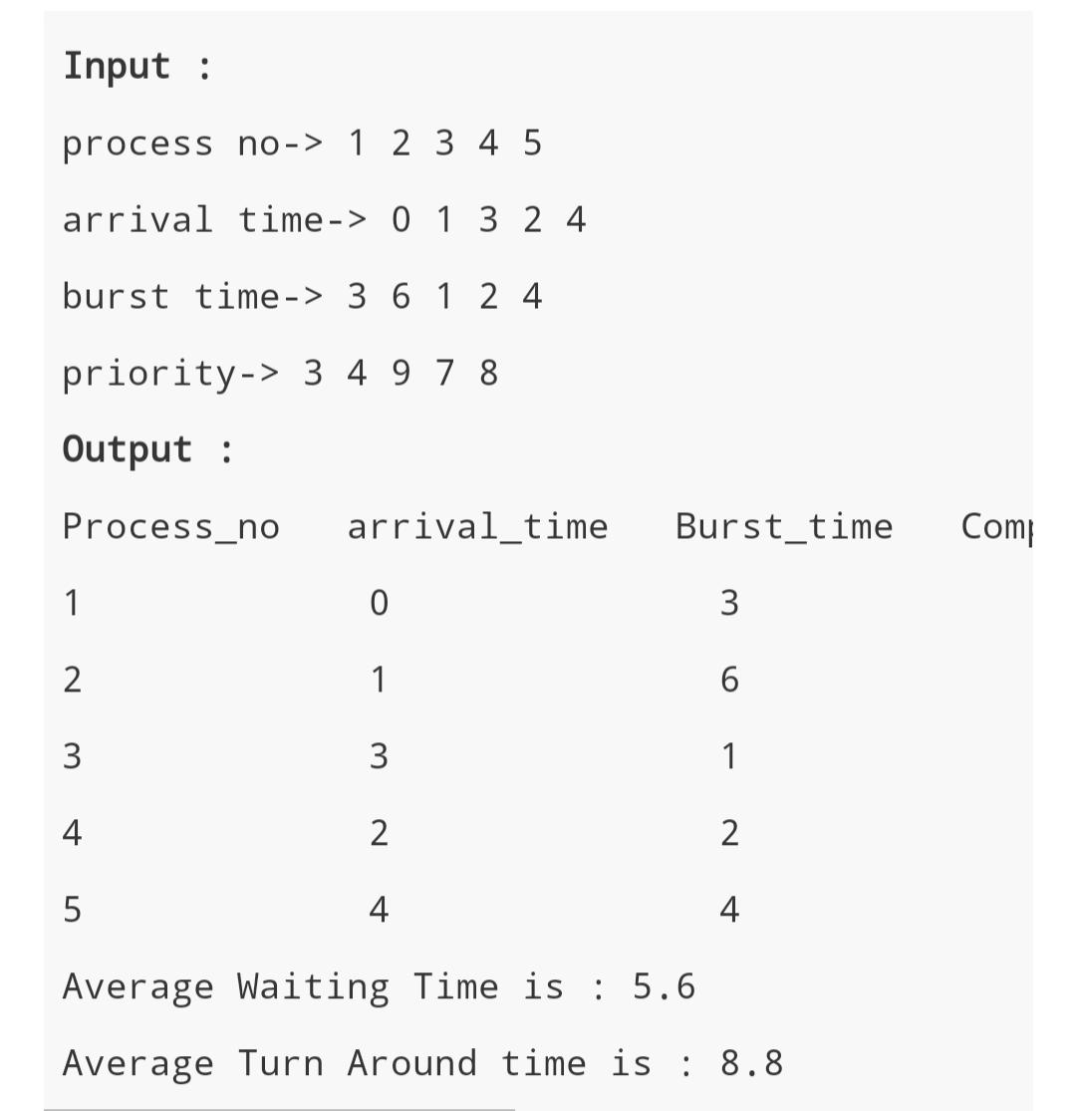
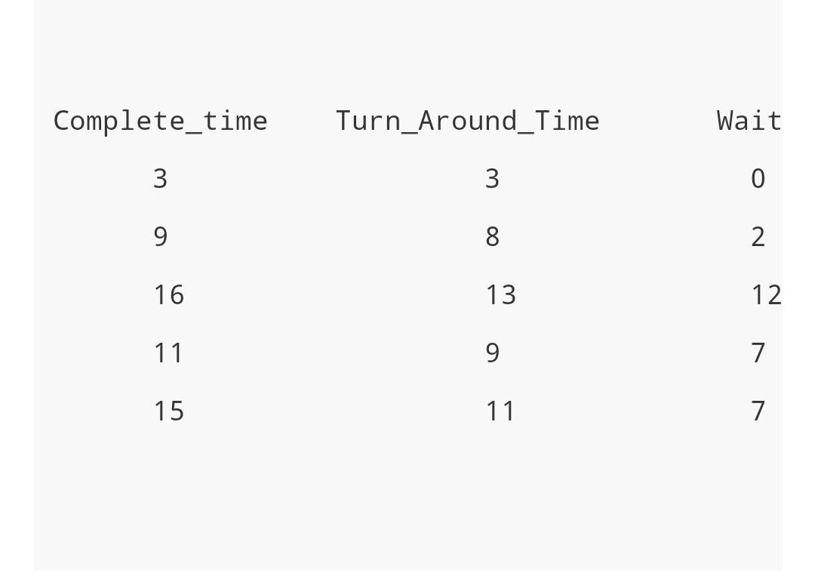
Priority scheduling-Nonpreemptive

Slide 66
Multilevel Queue Scheduling
multilevel queue-scheduling algorithm partitions the ready queue into several separate queues .
The processes are permanently assigned to one queue, generally based on some property of the process, such as memory size, process priority, or process type. Each queue has its own scheduling algorithm.

Slide 67
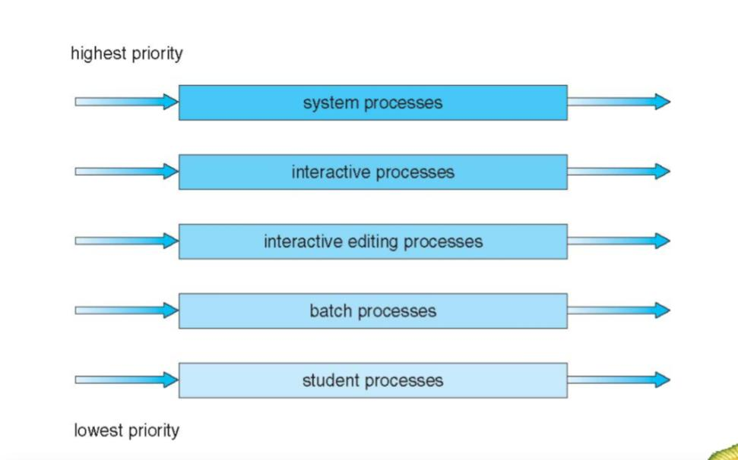
Multilevel Queue Scheduling

Slide 68
Multilevel Queue Scheduling
there must be scheduling among the queues, which is commonly implemented as fixed-priority preemptive scheduling.
Each queue has absolute priority over lower-priority queues. No process in the batch queue, for example, could run unless the queues for system processes, interactive processes, and interactive editing processes were all empty

Slide 69
Multilevel Feedback Queue Scheduling
Multilevel feedback queue scheduling, however, allows a process to move between queues.
The idea is to separate processes with different CPU-burst characteristics.

Slide 70
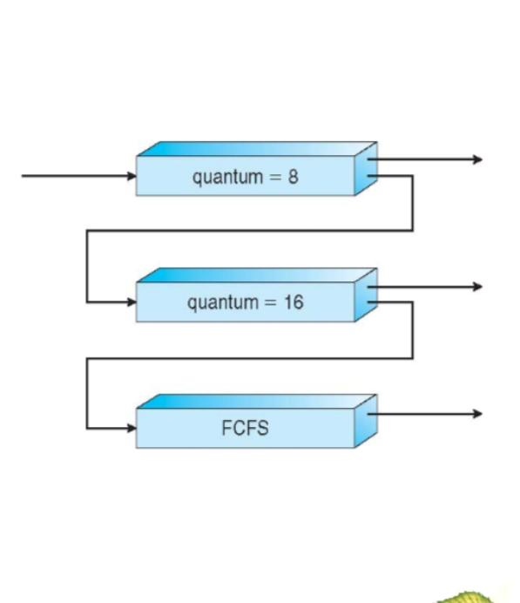
Multilevel Feedback Queue Scheduling

Slide 71
Multilevel Feedback Queue Scheduling
a multilevel feedback queue scheduler with three queues, numbered from 0 to 2 .
The scheduler first executes all processes in queue 0. Only when queue 0 is empty will it execute processes in queue 1. Similarly, processes in queue 2 will be executed only if queues 0 and 1 are empty

Slide 72
Multilevel Feedback Queue Scheduling
A process entering the ready queue is put in queue 0. A process in queue 0 is given a time quantum of 8milliseconds. If it does not finish within this time, it is moved to the tail of queue 1.
If queue 0 is empty, the process at the head of queue 1 is given a quantum of 16 milliseconds. If it does not complete, it is preempted and is put into queue 2.
Processes in queue 2 are run on an FCFS basis, only when queues 0 and 1 are empty.

Slide 73
Multilevel Feedback Queue Scheduling
A multilevel feedback queue scheduler is defined by the following parameters: The number of queues The scheduling algorithm for each queue The method used to determine when to upgrade a process to a higher priority queue The method used to determine when to demote a process to a lower-priority queue The method used to determine which queue a process will enter when that process needs service

Slide 74
Interprocess communication(IPC)
Process can be of two types: Independent process. Co-operating process
independent process is not affected by the execution of other processes while a co-operating process can be affected by other executing processes.

Slide 75
Interprocess communication
Inter-process communication (IPC) is a mechanism that allows processes to communicate with each other and synchronize their actions.
The communication between these processes can be seen as a method of co-operation between them.

Slide 76
Interprocess communication
IPC is particularly useful in a distributed environment where the communicating processes may reside on different computers connected with a network.
An example is a chat program used on the World Wide Web.
2 models for interprocess communication Shared Memory Message passing

Slide 77
Interprocess communication

Slide 78
Message-Passing System
Communication among the user processes is accomplished through the passing of messages.
An IPC facility provides at least the two operations: 1)send(message)
2) receive(message)
processes P and Q want to communicate, they must send messages to and receive messages from each other; a communication link must exist between them

Slide 79
Message-Passing System
Processes that want to communicate must have a way to refer to each other. They can use either direct or indirect communication.
Direct Communication
With direct communication, each process that wants to communicate must explicitly name the recipient or sender of the communication.
In this scheme, the send and receive primitives are defined as:

Slide 80
Message-Passing System
send(P, message) –send a message to process P
receive(Q, message) –receive a message from process Q
Communication link in this scheme has the following properties: A link is established automatically between every pair of processes that want to communicate.

Slide 81
Message-Passing System
Indirect Communication
With indirect communication, the messages are sent to and received from mailboxes, or ports which messages can be placed by processes and from which messages can be removed.
Each mailbox has a unique identification. In this scheme, a process can communicate with some other process via a number of different mailboxes.

Slide 82
Message-Passing System
Two processes can communicate only if they share a mailbox. The send and receive primitives are defined as follows:
send (A, message) -Send a message to mailbox A.
receive (A, message) -Receive a message from mailbox A
In this scheme, a communication link has the following properties: A link is established between a pair of processes only if both members of the pair have a shared mailbox. A link may be associated with more than two processes.

Slide 83
Synchronization
Message passing may be either blocking or nonblocking-also known as synchronous and asynchronous. Blocking send: The sending process is blocked until the message is received by the receiving process or by the mailbox. Nonblocking send: The sending process sends the message and resumes operation. Blocking receive: The receiver blocks until a message is available. Nonblocking receive: The receiver retrieves either a valid message or a null.

Slide 84
Buffering
Whether the communication is direct or indirect, messages exchanged by communicating processes reside in a temporary queue. Basically, such a queue can be implemented in three ways:
Zero capacity: The queue has maximum length 0; thus, the link cannot have any messages waiting in it. In this case, the sender must block until the recipient receives the message.

Slide 85
Buffering
Bounded capacity: The queue has finite length n; thus, at most n messages can reside in it.
Unbounded capacity: The queue has potentially infinite length; thus, any number of messages can wait in it. The sender never blocks
The zero-capacity case is sometimes referred to as a message system with no buffering; the other cases are referred to as automatic buffering.

Slide 86
Shared Memory
An area of memory shared among the processes that wish to communicate
The communication is under the control of the users processes not the operating system.
Major issues is to provide mechanism that will allow the user processes to synchronize their actions when they access shared memory.

Slide 87
Producer-Consumer Problem
Bounded-Buffer – Producer
item next_produced;
while (true) {
/* produce an item in next produced */
while (((in + 1) % BUFFER_SIZE) == out)
; /* do nothing */
buffer[in] = next_produced;
in = (in + 1) % BUFFER_SIZE;
}

Slide 88
Bounded Buffer – Consumer
item next_consumed;
while (true) { while (in == out)
; /* do nothing */ next_consumed = buffer[out];
out = (out + 1) % BUFFER_SIZE;
/* consume the item in next consumed */
}

